Slide 1


Mohamed Emad Mohamed
Data Science Capstone Project
August 2024
emadeemad41@email.com

Slide 2
Outline
•Executive Summary
•Introduction
•Methodology
•Results
•Conclusion
•Appendix

Slide 3
Executive Summary
Summary of methodologies
- Data collection
- Data wrangling
- Exploratory Data Analysis with Data Visualization
- Exploratory Data Analysis with SQL
- Building an interactive map with Folium
- Building a Dashboard with Plotly Dash
- Predictive analysis (Classification)
Summary of all results
- Exploratory Data Analysis results
- Interactive analytics demo in screenshots
- Predictive analysis results

Slide 4
Introduction
Project background and context
SpaceX has become a leader in the commercial space industry by making space travel more affordable, primarily due to its ability to reuse the first stage of its Falcon 9 rockets. With launch costs at $62 million, significantly lower than competitors, predicting whether the first stage will land is crucial for determining launch costs. This project aims to use public data and machine learning models to predict the likelihood of the first stage being reused.
Questions to be answered:
- How do variables such as payload mass, launch site, number of
flights, and orbits affect the success of the first stage landing?
- Does the rate of successful landings increase over the years?
- What is the best algorithm that can be used for binary classification
in this case?

Slide 5
Methodology
Data collection methodology:
- Using SpaceX Rest API
- Using Web Scrapping from Wikipedia
Performed data wrangling
- Filtering the data
- Dealing with missing values
- Using One Hot Encoding to prepare the data to a binary classification Performed exploratory data analysis (EDA) using visualization and SQL Performed interactive visual analytics using Folium and Plotly Dash Performed predictive analysis using classification models.
- Building, tuning and evaluation of classification models to ensure the best results.

Slide 6
Data collection
-Data collection process involved a combination of API requests from SpaceX REST
API and Web Scraping data from a table in SpaceX’s Wikipedia entry.
-We had to use both of these data collection methods in order to get complete
information about the launches for a more detailed analysis.
Data Columns are obtained by using SpaceX REST API:
FlightNumber, Date, BoosterVersion, PayloadMass, Orbit,
LaunchSite, Outcome, Flights, GridFins, Reused, Legs, LandingPad, Block, ReusedCount,
Serial, Longitude, Latitude
Data Columns are obtained by using Wikipedia Web Scraping:
Flight No., Launch site, Payload, PayloadMass, Orbit, Customer, Launch
outcome, Version Booster, Booster landing, Date, Time

Slide 7
Data collection – SpaceX API
Requesting rocket launch data from SpaceX API.
Decoding the response content using .json() and turning it into a dataframe using .json_normalize().
3. Requesting needed information about the launches from SpaceX API by applying custom functions.
Constructing data we have obtained into a dictionary.
Creating a data frame from the dictionary.
Filtering the dataframe to only include Falcon 9 launches.
Replacing missing values of Payload Mass column with calculated .mean() for this column.
Exporting the data to CSV.

Slide 8
Data wrangling
Perform exploratory Data Analysis and determine Training Labels.
Calculate the number of launches on each site.
Calculate the number and occurrence of each orbit.
Calculate the number and occurrence of mission outcome per orbit type.
Create a landing outcome label from Outcome column.
Exporting the data to CSV.

Slide 9
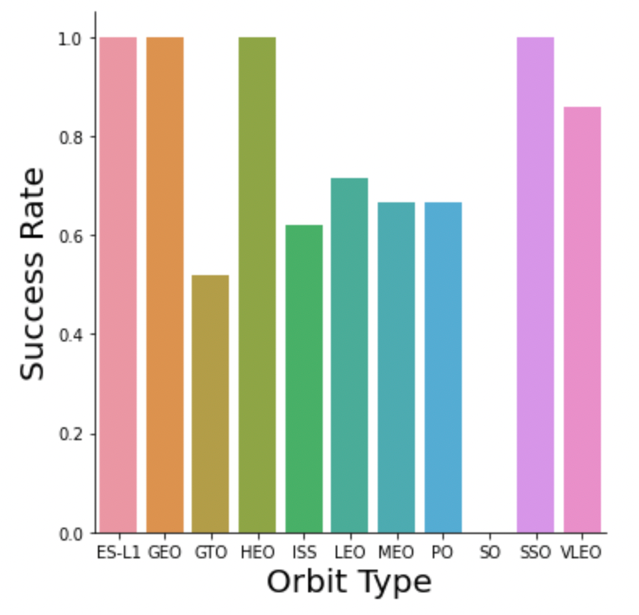
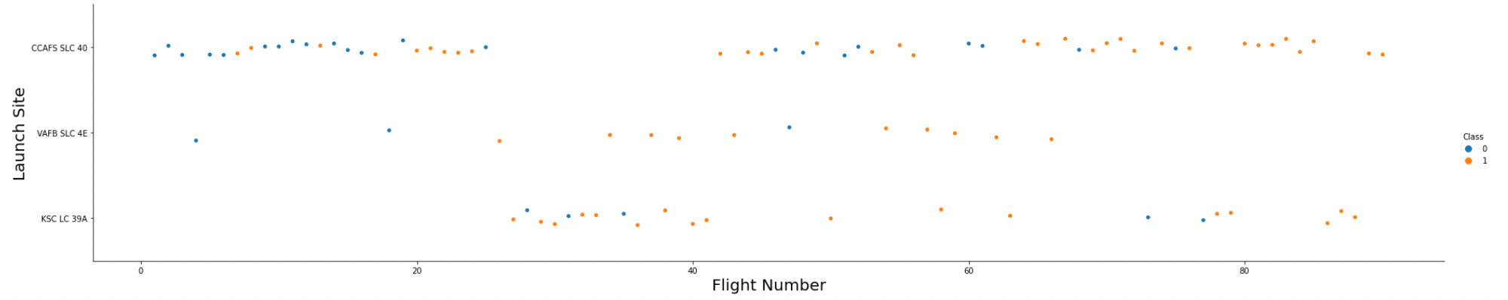
EDA with data visualization
Charts were plotted:
Flight Number vs. Payload Mass, Flight Number vs. Launch Site, Payload Mass
vs. Launch Site, Orbit Type vs. Success Rate, Flight Number vs. Orbit Type, Payload Mass vs Orbit Type and Success Rate Yearly Trend
-Scatter plots show the relationship between variables. If a relationship exists,
they could be used in machine learning model.
-Bar charts show comparisons among discrete categories. The goal is to show the
relationship between the specific categories being compared and a measured value.
-Line charts show trends in data over time (time series).

Slide 10
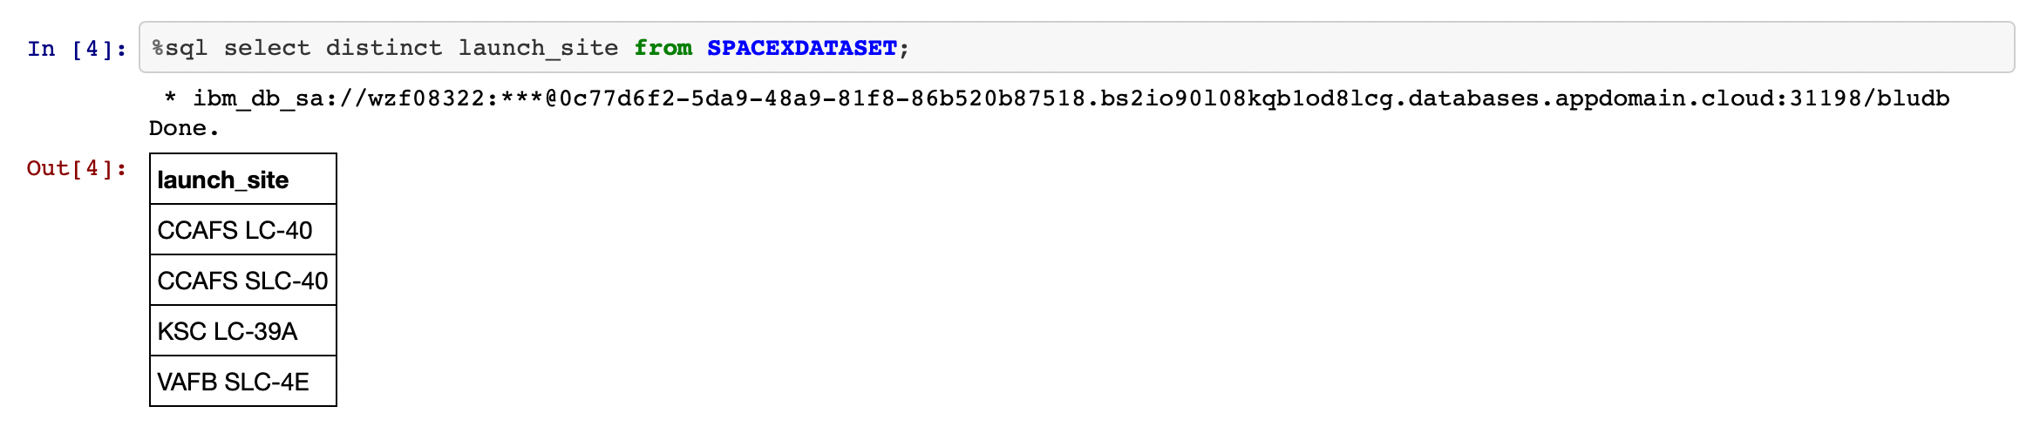
EDA with SQL
Performed SQL queries:
• Displaying the names of the unique launch sites in the space mission.
• Displaying 5 records where launch sites begin with the string ‘CCA'.
• Displaying the total payload mass carried by boosters launched by NASA (CRS).
• Displaying average payload mass carried by booster version F9 v1.1.
• Listing the date when the first successful landing outcome in ground pad was achieved.
• Listing the total number of successful and failure mission outcomes.
• Listing the names of the booster versions which have carried the maximum payload mass.
• Ranking the count of landing outcomes (such as Failure (drone ship) or Success (ground pad)) between the date
2010-06-04 and 2017-03-20 in descending order.

Slide 11
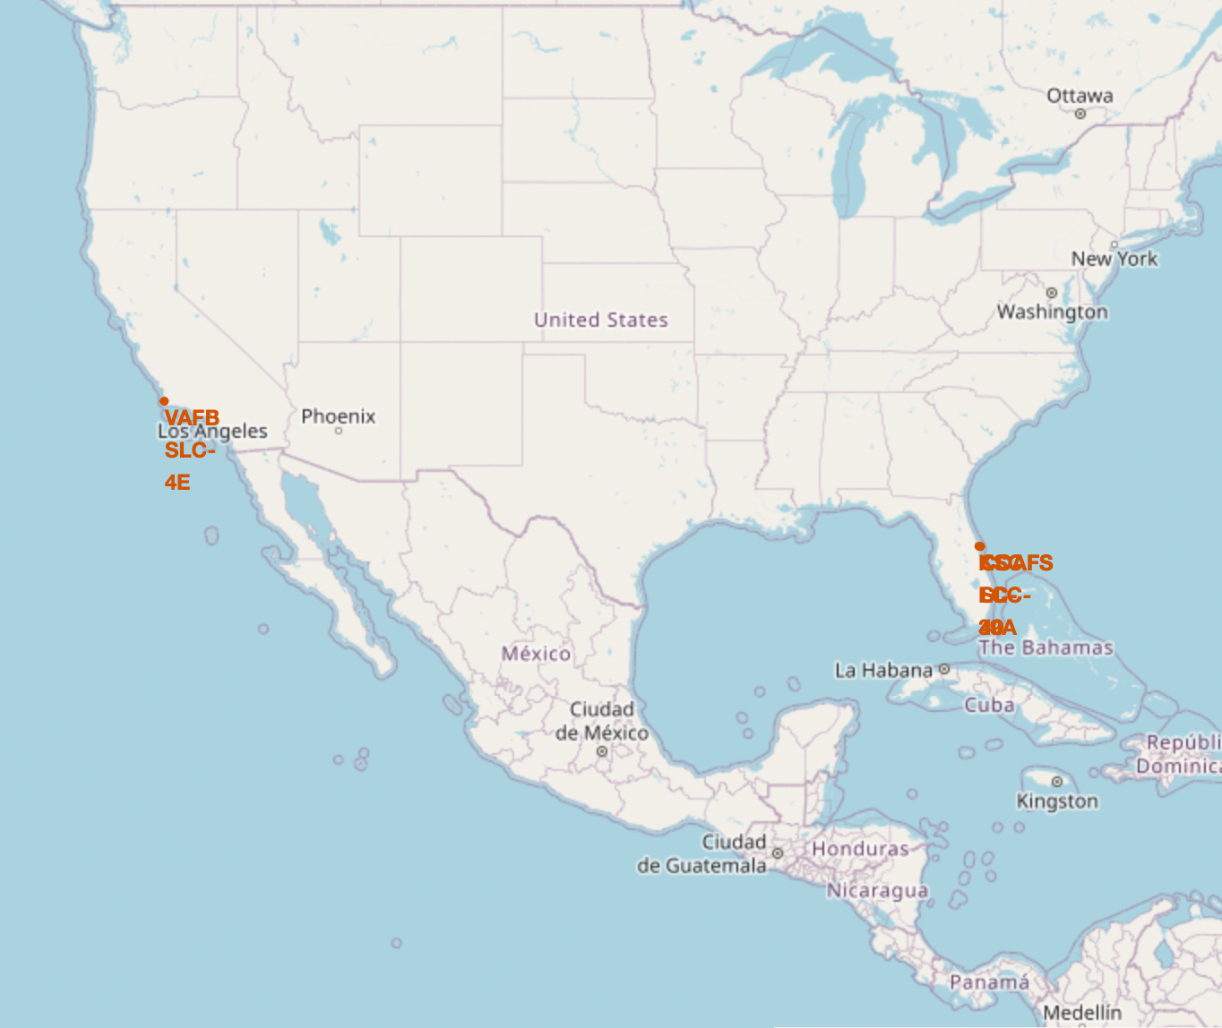
Build an interactive map with Folium
Markers of all Launch Sites:
- Added Marker with Circle, Popup Label and Text Label of NASA Johnson Space Center using its latitude and longitude coordinates as a start location.
- Added Markers with Circle, Popup Label and Text Label of all Launch Sites using their latitude and longitude coordinates to show their geographical locations and proximity to Equator and coasts.
Coloured Markers of the launch outcomes for each Launch Site:
- Added coloured Markers of success (Green) and failed (Red) launches using Marker Cluster to identify which launch sites have relatively high success rates.

Slide 12
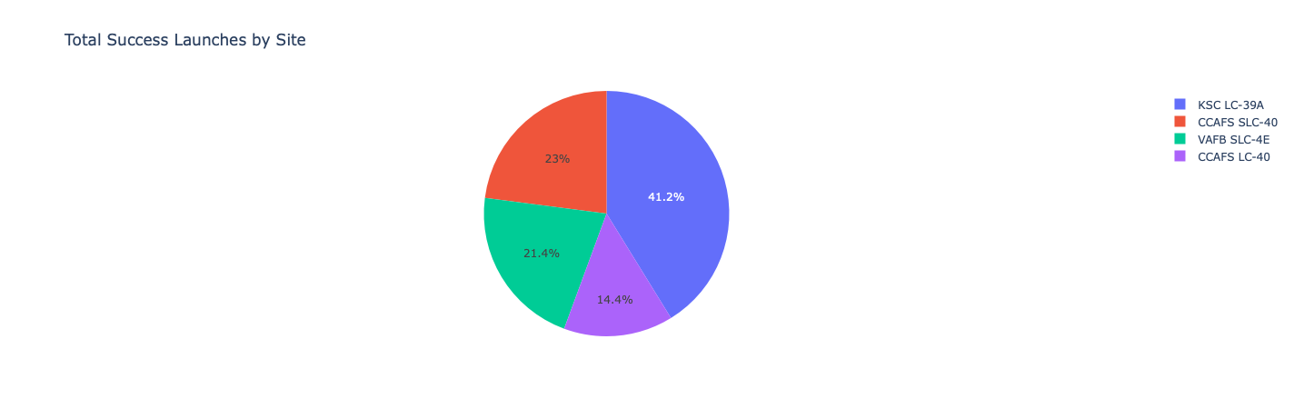
Build a Dashboard with Plotly Dash
Launch Sites Dropdown List:
- Added a dropdown list to enable Launch Site selection.
Pie Chart showing Success Launches (All Sites/Certain Site):
- Added a pie chart to show the total successful launches count for all sites and the
Success vs. Failed counts for the site, if a specific Launch Site was selected.
Slider of Payload Mass Range:
- Added a slider to select Payload range.
Scatter Chart of Payload Mass vs. Success Rate for the different Booster Versions:
- Added a scatter chart to show the correlation between Payload and Launch Success.

Slide 13
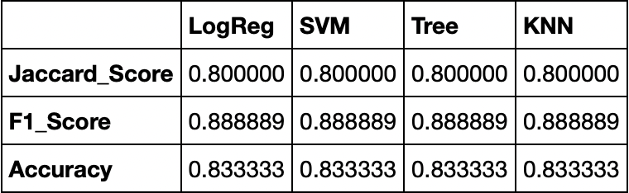
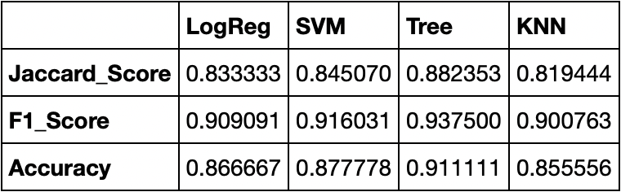
Predictive analysis (Classification)
Creating a NumPy array from the column “Class” in data.
Standardizing the data with StandardScaler, then fitting and transforming it.
Splitting the data into training and testing sets with train_test_split function.
Creating a GridSearchCV object with cv = 10 to find the best parameters.
Applying GridSearchCV on LogReg, SVM, Decision Tree, and KNN models.
Calculating the accuracy on the test data using the method .score() for all models.
Examining the confusion matrix for all models.
Finding the method performs best by examining the Jaccard_score and F1_score metrics.
Scores and Accuracy of the Test Set
Scores and Accuracy of the Entire Data Set

Slide 14
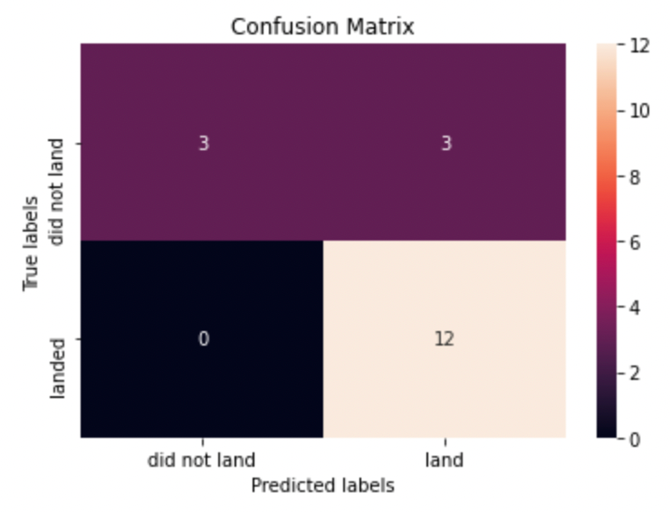
Confusion Matrix

Slide 15
Conclusion
• Decision Tree Model is the best algorithm for this dataset.
• Launches with a low payload mass show better results
than launches with a larger payload mass.
• Most of launch sites are in proximity to the Equator line
and all the sites are in very close proximity to the coast.
• The success rate of launches increases over the years.
• KSC LC-39A has the highest success rate of the launches
from all the sites.
• Orbits ES-L1, GEO, HEO and SSO have 100% success rate.

Slide 16
Appendix
Special Thanks to: Instructors
Coursera
IBM

Slide 17



